Slide 1
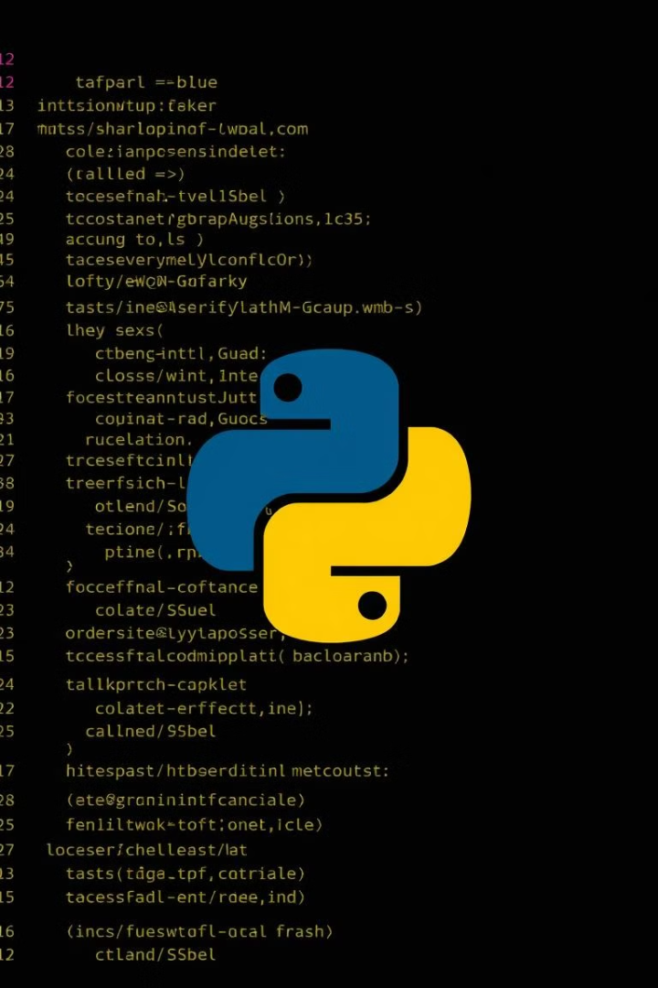
Clean Code Chapter 7
Generators, Iterators, and Asynchronous Programming

Slide 2
What is an Iteration?
A process that is repeated more than one time by applying the same logic is called an Iteration. In programming languages like python, a loop is created with few conditions to perform iteration till it exceeds the limit.
Geeks for geeks
Example:
If the loop is executed 5 times continuously, then we could say the particular block has iterated 5 times.
a = [0, 5, 10, 15, 20]
for i in a:
if i % 2 == 0:
print(str(i)+' is an Even Number')
else:
print(str(i)+' is an Odd Number')

Slide 3
Output:
0 is an Even Number
5 is an Odd Number
10 is an Even Number
15 is an Odd Number
20 is an Even Number

Slide 4
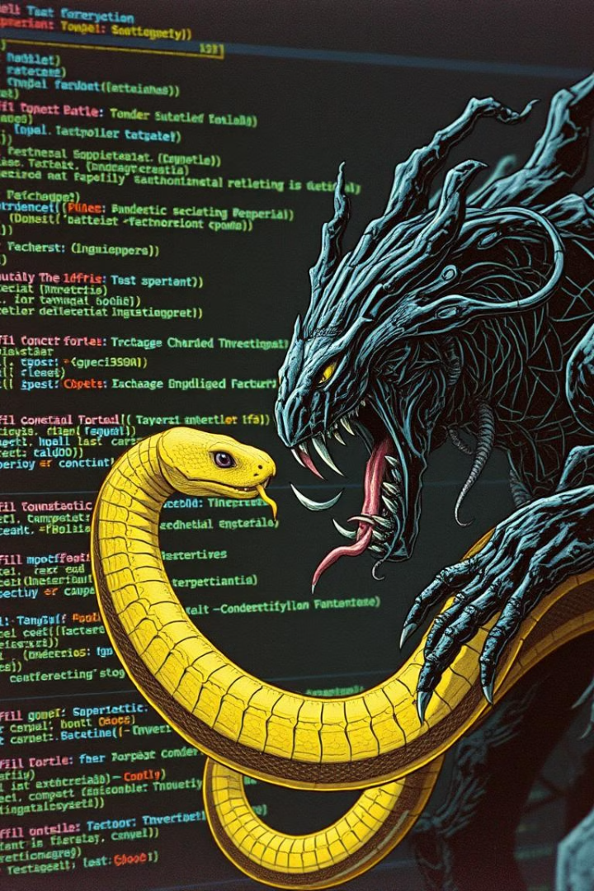
What is the problem?

Slide 5
Problems before Iterators:
Complex of Iteration Logic
Inefficient Memory Usage
Rigid and Repetitive Code
Limited Flexibility for Complex Iterations
Manually managing indices
Infinite sequences was a nightmare
Hard to reusing iteration logic across different projects
Filtering
Skipping
Hard to keep track of state while looping
Generating dynamic sequences
Answer?

Slide 6
Iterators (ع)

Slide 7
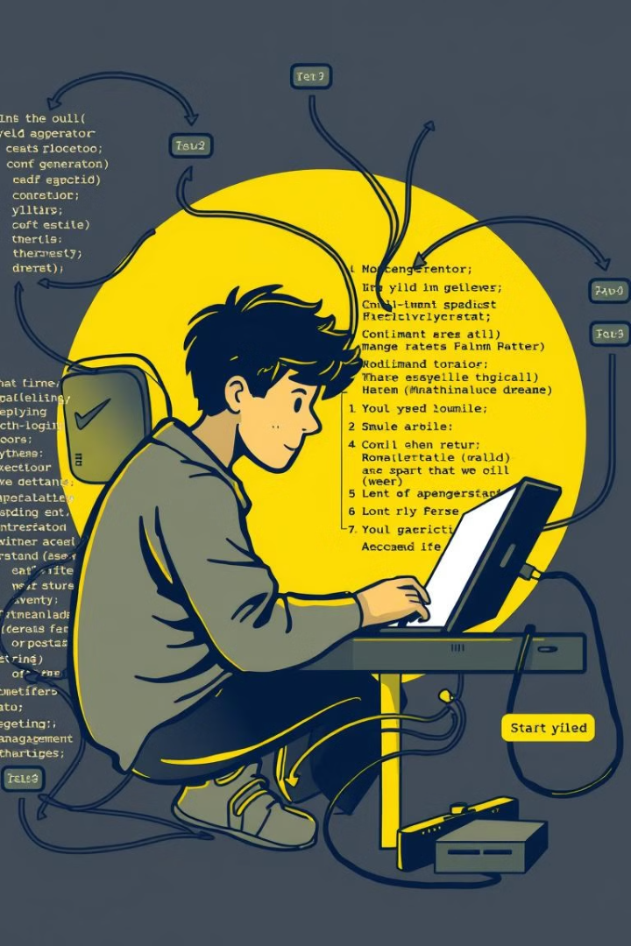
What is Iterator?
1
Iterators are implemented using a class
a local variable for iterating is not required
required iter() function
required next() function
required prev() function?
p.s: After the iterable object is completed, to use them again reassign them to the same object.
2
Iterators follows Lazy Computation
wastage of RAM space will be reduced

Slide 8
So… What is Generator?
Generators are another way of creating iterators in a simple way where it uses the keyword “yield” instead of returning it in a defined function.
Generators are implemented using a function.

Slide 9
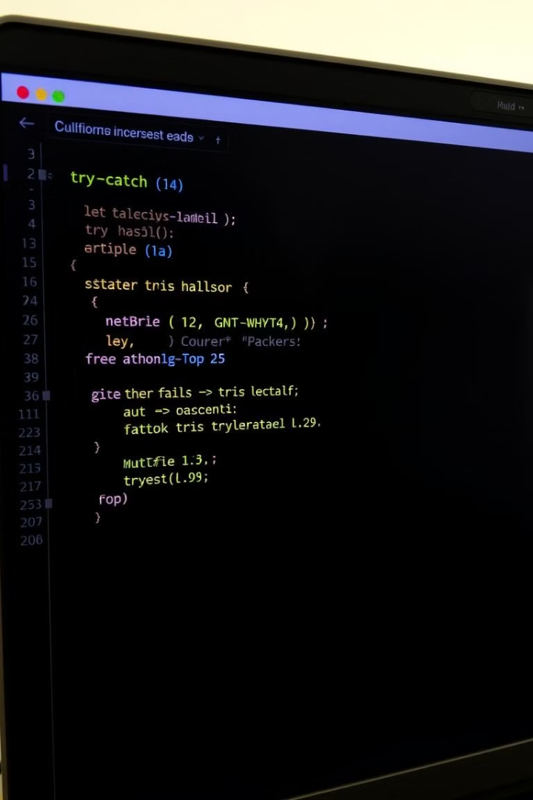
Requirements:
Python 2.2 added the iterator protocol, making objects like lists, dictionaries, and files iterable using the for loop.
Generators were later introduced in Python 2.3 (released on July 29, 2003) with the yield keyword, enabling lazy evaluation and creating sequences on demand.

